Slide 1
SonATA:
SETI on the ATA

Slide 2
ATA vs SonATA Development
ATA
H/W cost >> NRE
Minimize cost by
  Innovative design
  Higher NRE for lower build costs
Revolutionary (risky)
SonATA
NRE >> H/W cost
Minimize cost by
  COTS design
  Higher H/W cost for lower NRE
  Recycle ATA design
Evolutionary (safe)
Must “fit” existing ATA design

Slide 3
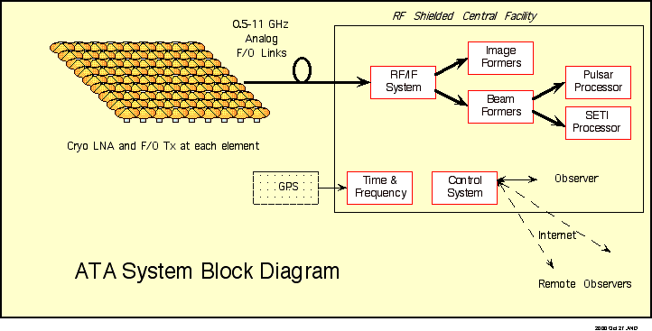
Allen Telescope Array

Slide 4
Allen Telescope Array

Slide 5
ATA Signal Path
RF: 0.5-11.2 GHz
IF: 1-2 GHz
from other antennas
optical fibers
digitize, track
detect
Front End
RF to IF
Converters
IF Processor
Antenna
back ends
IF Processor
Tunable LOs
f_{A}
back ends
f_{B}
IF Processor
f_{C}
f_{D}
back ends
IF Processor
back ends

Slide 6
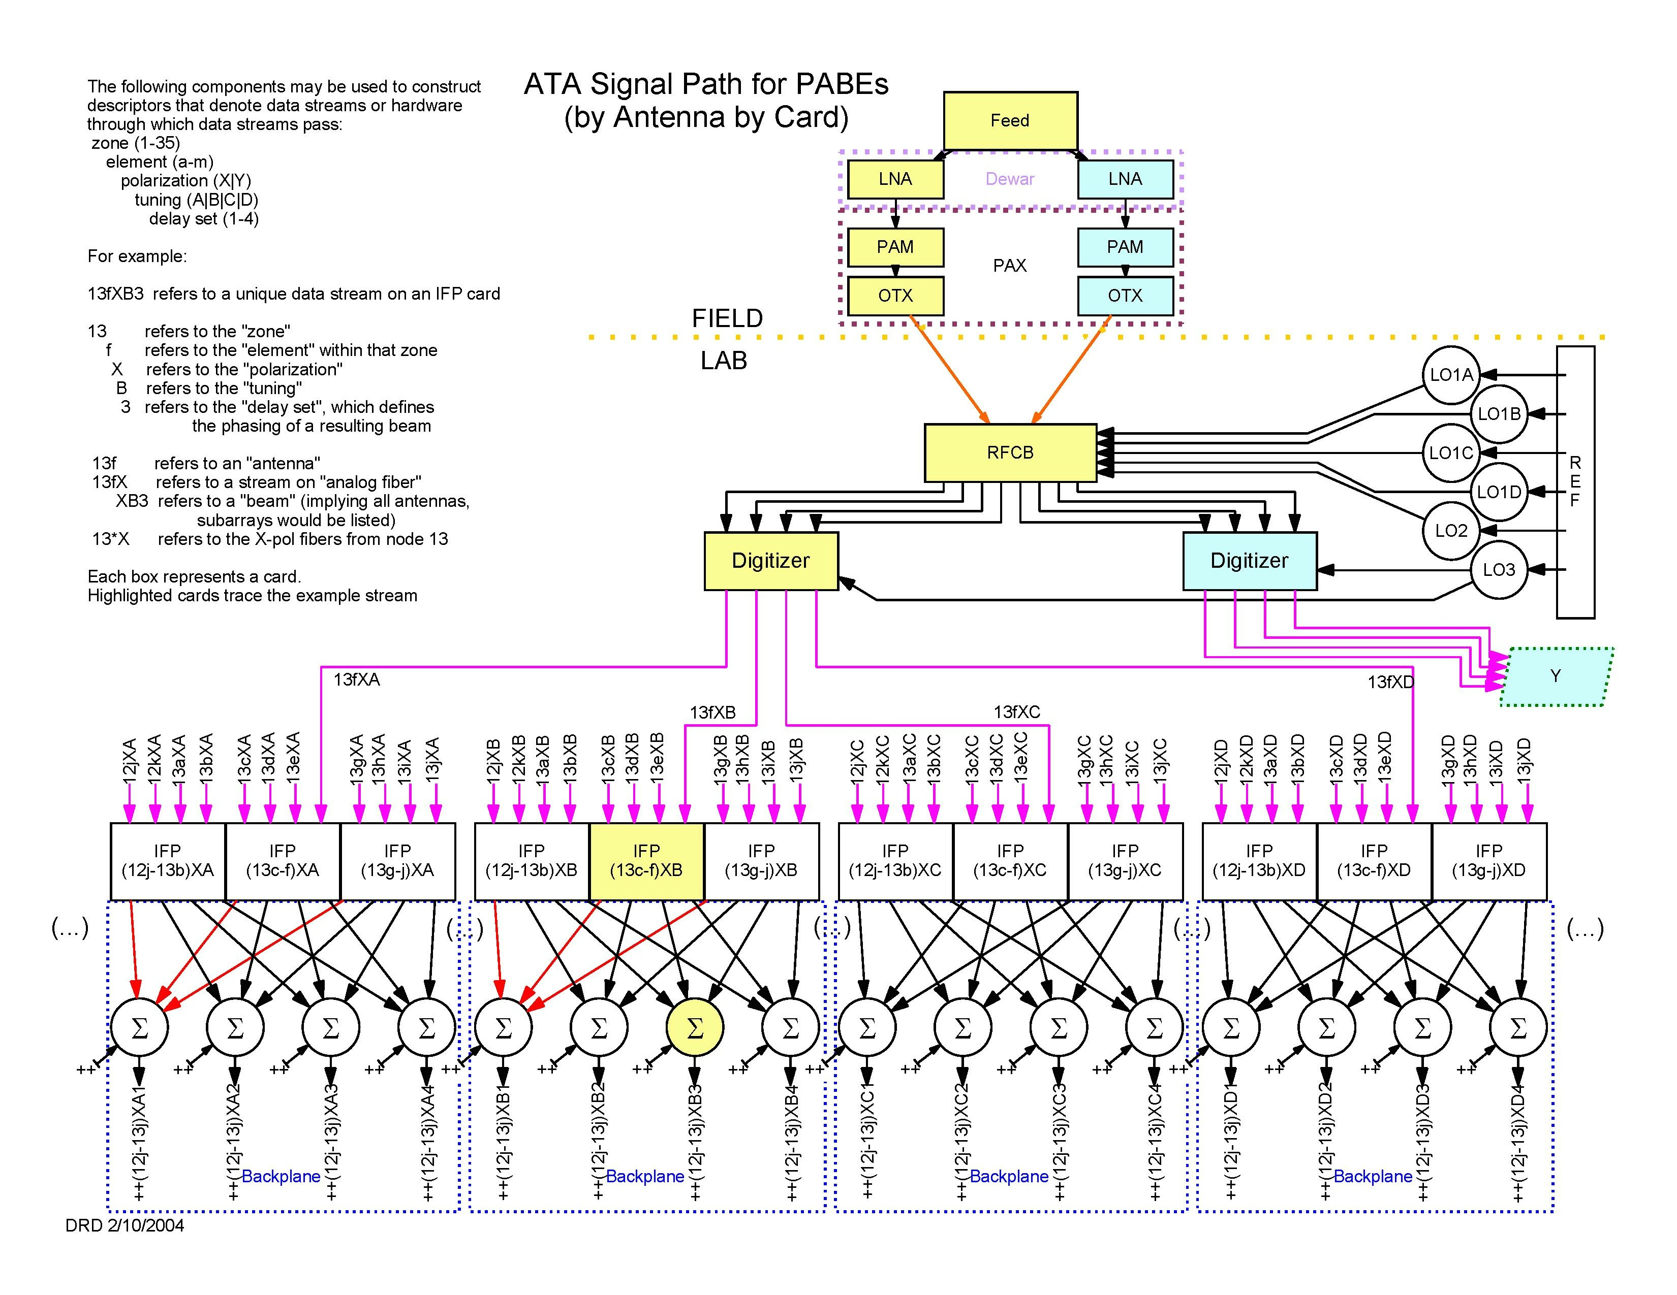

Slide 7
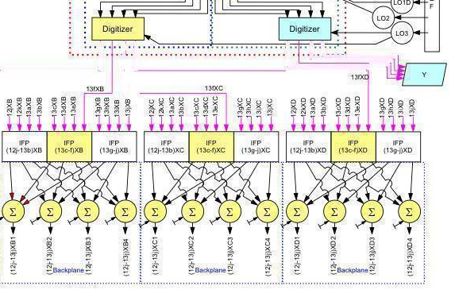
3.4 Gb/s
3.4 Gb/s
PANDI

Slide 8
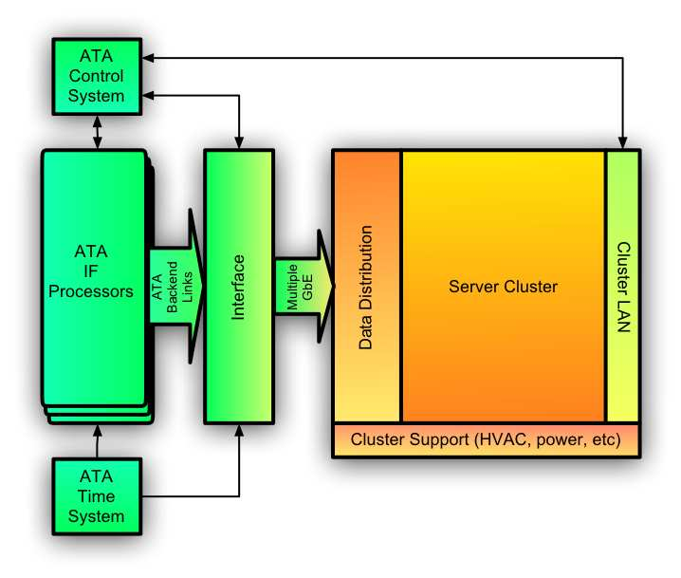
PANDI

Slide 9
Sonata Systems
ATA Interface (PANDI)
Software
  DX -- software signal detectors
  SSX -- Enhanced Search System Executive
Hardware
  Server Cluster, ~100 nodes
  Data LAN, control LAN
  Support: racking, cooling, power distribution…

Slide 10
I/O Rates (Gbits/sec)
 | Per element | Array
Digitizer | 20 | 7,000
IFP (backplane) | 160 | 56,000
PANDI (in) |  | 6.7 per beam
PANDI (out) |  | 1.7 per beam
PCI-X 133 (now) | 8.5
PCI-? (2005?) | 10 to 40
Gigabit Ethernet | 0.9

Slide 11
Sonata Software
DX -- software signal detectors
  Sample data in ~100 kHz streams
  Search Detectors
    Non-drifting CW (in inertial frame), ~100 s coherence
    Drifitng CW, ~1 sec coherence, ~100 sec power accumulation
    Multi-resolution pulse detectors
    Clustering of detector reports into compact representations
  Very-long baseline interferometer for confirmation
SSX -- Enhanced Search System Executive
  Star selection, scheduling, verification logic
  Report handling with database
  Operation of DX, hierarchical design for multiple beams
  Interface to ATA Control System

Slide 12
Sonata Software Development
Sonata is primarily a software project dominated by NRE rather than hardware
  Optimize for minimal design cost (NRE)
    Optimize only as cost effective
    Generic optimizations that are less dependent on H/W details
    RAM based, mostly floating point
  H/W costs are operations costs
    First set of H/W included in development
    Replace H/W at 3-5 year intervals
Software reuse
  DX based on PDM “model” code developed for NSS
  SSX is an enhanced version of existing SSE that is running NSS
  Leverage ATA software (distributed Java system)
Control requirements to contain costs
  Prioritized requirement list
  Budget and time determine how far down the list we get

Slide 13
Detector H/W Costs
Phoenix 1993 100 k$/MHz
NSS 2003 10 k$/MHz
Sonata 2005 1 k$/MHz
  Low end server costs 2-3 k$
  Processes 1-2 MHz (2003), 2-4 MHz (2005)
  ~400 MHz -> 400 k$ for H/W
  400 k$ ~ 2.5 FTE years, so Sonata H/W costs will be “negligible” part of total

Slide 14
Minimizing Cost
Keep things simple.
Prioritize tasks.
  Distinguish the essential from the good.
  There are no requirements but success.
Be frugal.
  Don’t spend much NRE on optimization.
  Write code for durability to reduce lifecycle costs.
  Select H/W to minimize maintenance.
Keep things simple.
Have fun.

Slide 15
Major Upgrade Cycle
ATA plans to replace digital IF every 3-5 years, hence Sonata will do the same
  More BW
  Better RFI removal -> may propagate into SETI detectors (next gen)
  More beams and/or tunings
ATA first upgrade may be deferred in favor of more antennas

Slide 16
Minor Upgrade Cycle
Continuous innovation
  New detector types
  Improved algorithms
  Better RFI handling
Leapfrog DX H/W
  Develop on next generation
  Overlapped deployment
Prototype next gen Sonata on next gen ATA prototype IFP’s

Slide 17
Schedule
Nominal set by ATA (2007?)
Actual is ~2 years after resources (money) allocated.
Next steps
  Work groups on PANDI, DX, SSX
  Strawman design and goals
  Find and work with industrial partners

Slide 18
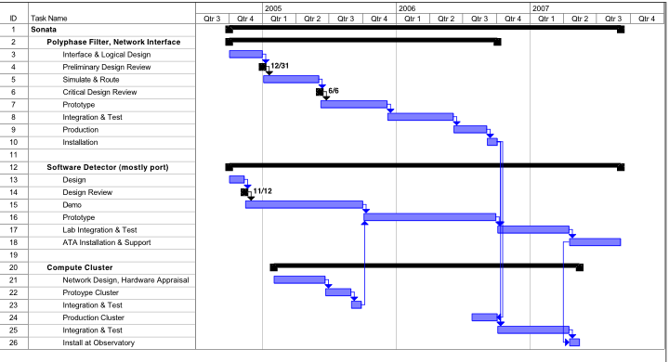
Preliminary Schedule

